Slide 1
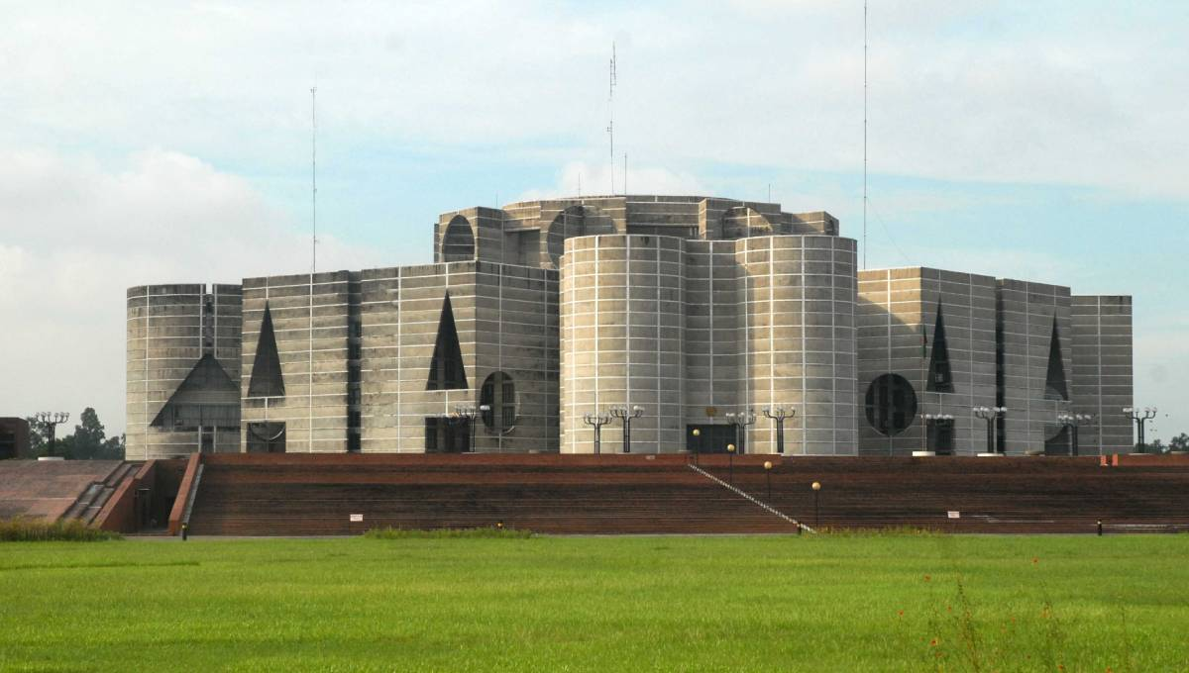

Parliamentary system in Bangladesh
Nabila Jahan Rimu
Roll : 26
Office-16

Slide 2



The people’s republic of Bangladesh is unitary , independent and sovereign republic which has a parliamentary government system. The president is constitutional figure head and elected by the members of parliament for the tenure of 5 years.
The government has 3 organs.
Legislature - Make the law
Executive - Implement the law
Judiciary - Interprets the law

Slide 3

Legislature of Bangladesh
The Constitution of the People's Republic of Bangladesh gives the legislature the name Jatiyo Shangsad in Bengali and House of the Nation in English. It is commonly known as Parliament.

Slide 4
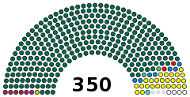
Formation of Parliament
Formation of Parliament :
Total Member : 350
Male : 300 , directly elected by the adult people ( from 300 territorial constituencies that is one from each constituency )
Female: 50 , elected by MPs

Slide 5
The title is almost always shortened to the initialism "MP" and often
referred to simply as the Sānsad (Bengali: সাংসদ; the Parliamentarian) in Bengali.
Members of Parliament are entitled to use the prefix "The Honourable".

Slide 6
Tenure of Parliament:
The term of a Parliament is five years, as per provision of clause (3) of article 72 of the Constitution.

Slide 7
History of Bangladesh Parliament
The Constituent Assembly of Bangladesh was established on 10 April 1972 after the Bangladesh Liberation War to prepare a democratic constitution and served as its first parliament as an independent nation. The assembly approved the constitution on 4 November 1972, and it took effect on 16 December.
Until 10 July 1981 the Constituent Assembly, and the first and second parliaments held their sittings in the building that now houses the Prime Minister's Office and which is often referred as the old Sangsad Bhaban (old Parliament House). The opening ceremony of the present Parliament House was performed on 15 February 1982.

Slide 8
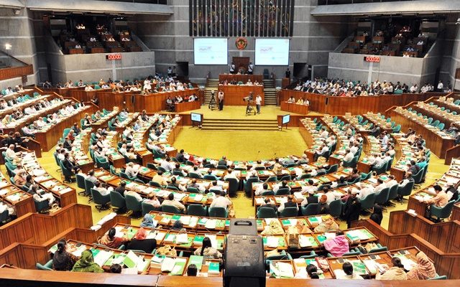
How to be a Member of Parliament
To qualify, candidates must be citizens of Bangladesh and at least 25 years of age (Article 66).
Article 66 of the Constitution makes membership open to any citizen of Bangladesh.

Slide 9
Dual citizenship is possible for civilians in Bangladesh, but not for MPs.
Members are elected by direct polls in their respective constituencies. Whoever wins the most votes, regardless of turnout or proportion, wins the election.

Slide 10
Floor Crossing : A questionable issue
Article 70 of the Constitution makes floor crossing illegal. Members engaging in floor crossing lose their membership.
Floor crossing is described in the Constitution as:
Resignation from the political party that nominated the member,
Voting against the nominating party
Abstaining from voting, either by abstention or absence, against the directive of the party Whip

Slide 11
Conditions for Vacating Seats
The constitution elaborates situations when a seat may be vacated (Article 67). These include:
failure to take oath within 90 days
(b) being absent from parliamentary sittings for 90 consecutive days without getting prior approval
(c) upon dissolution of parliament
(d) resignation; and,
(e) in the circumstances specified in Article 70.

Slide 12
How to appoint a Prime Minister
According to the Constitution the prime minister is appointed by the President based upon the result of the electorates choice in parliamentary general election held by the Election Commission. He / she is the CEO of government, head of cabinet.
The Prime Minister will be the leader of the majority party (or coalition) in the Jatiya Sangsad and must have the confidence of the Jatiya Sangsad to govern.
The cabinet is composed of ministers selected by the prime minister and appointed by the president. At least 90% of the ministers must be MPs. The other 10% may be non-MP experts or "technocrats" who are not otherwise disqualified from being elected MPs.

Slide 13
President Election
The President of Bangladesh is elected by the Parliament through open ballot voting.
As a result, the opposition party seldom nominates a candidate and the governing party nominee is uncontested.
The Parliament can also impeach the President by a two-thirds majority.

Slide 14
Key person of Bangladesh Parliament
Speaker and a Deputy Speaker should be appointed in the first sitting of parliament (Article 74).
Speaker is the most powerful of the parliament who is important for maintaining its public image as a representative.
The Speaker is usually chosen from one of the two largest parties in the parliament by the members.
Furthermore; whips, opposition leaders are part and parcel of parliament.

Slide 15
Whips:
Whips are key agents appointed by both the government and the opposition to ensure party discipline in legislature.
The role of the whip is basically to ensure the presence of the MPs when voting takes place.
For major votes, both the government and the opposition attempt to maximize turnout and the whip’s job is to ensure this takes place.

Slide 16
Key Persons of Present Parliament
President ( State Head ) : Mohammad Abdul Hamid
Prime Minister ( Cabinet Head ) : Sheikh Hasina
Speaker ( Parliament Head ) : Dr. Shirin Sharmin Chaudhury, MP

Slide 17
Tenure of All Parliament
Parliament | Date of First Sitting | Date of Dissolution | Actual Term
11th Parliament | January 30,2019 | Ongoing
10th Parliament | January 29, 2014 | October 29, 2018 | 5 years
9th Parliament | January 25, 2009 | November 20, 2013 | 5 years
8th Parliament | October 28,2001 | October 27,2006 | 5 years
7th Parliament | July 14, 1996 | July 13, 2001 | 5 years
6th Parliament | March 19,1996 | March 30,1996 | 12 days
5th Parliament | March 05,1991 | November 24,1995 | 4 years 8 months
4th Parliament | April 15,1988 | December 6,1990 | 2 years 7 months
3rd Parliament | July 10,1986 | December 6,1987 | 1 year 5 months
2nd Parliament | April 2,1979 | March 24,1982 | 2 years 11 months
1st Parliament | April 7,1973 | Nov.6, 1975 | 2 years 6 months

Slide 18
Sessions and Quorum
Article 72 specifies that a period exceeding 60 days will not intervene between two sessions of parliament.
After the declaration of the results of general elections, the parliament is to be summoned within 30 days and unless it is dissolved by the President, its tenure is set for five years from the date of its first meeting.

Slide 19
A sitting means the meeting of Parliament from the commencement of its business to the termination thereof for a day.
A meeting, which commences on a day and continues into the next day is considered to be a sitting of the day on which it commenced.
Once a session commences the Speaker may adjourn it to a date and time fixed by him.

Slide 20
The list of business for a sitting, prepared by Secretary of Parliament with the approval of the Speaker, is called the Orders of the Day, a copy of which is made available to all Members of Parliament at their addresses in Dhaka usually the night before the sitting.
Government business is transacted on four days of the week commencing on Sunday. The fifth day in the week, i.e. Thursday, is called Private Members' Day on which Private Members Business has preference.

Slide 21
Some business such as questions, call attention notices, questions of privileges, discussions for short duration, adjournment motions, and other matters which are essentially private members business, are transacted either on all days or, ironically, only on government days.
A Minister who is not a Member of Parliament does not enjoy the right to vote, nor can he speak in Parliament on any matter not related to his Ministry.

Slide 22
If the President's attention is drawn to any time during a session of Parliament where there are less than 60 members present, the Chair may either postpone the session or adjourn the session until at least 60 of them are present.
A session of Parliament is prorogued by the President upon the advice of the Prime Minister, which is tendered to him in writing.

Slide 23
Speaker of Bangladesh Parliament
The Speaker is the presiding officer of Parliament of Bangladesh.
The Speaker performs the functions of the President, if there is a temporary vacancy in that office or if the President is unable to perform her functions until a President is elected or the President resumes her duties, as the case may be;
The Speaker administers oath to members of parliament or nominates someone to do so;
The Speaker authenticates all Bills passed in Parliament when they are presented to the President for his assent. If a Bill bears a certificate under the hand of the Speaker that it is a 'money bill
Deputy speaker is responsible for assisting speaker. In the absence of speaker , Deputy speaker will play t

Slide 24
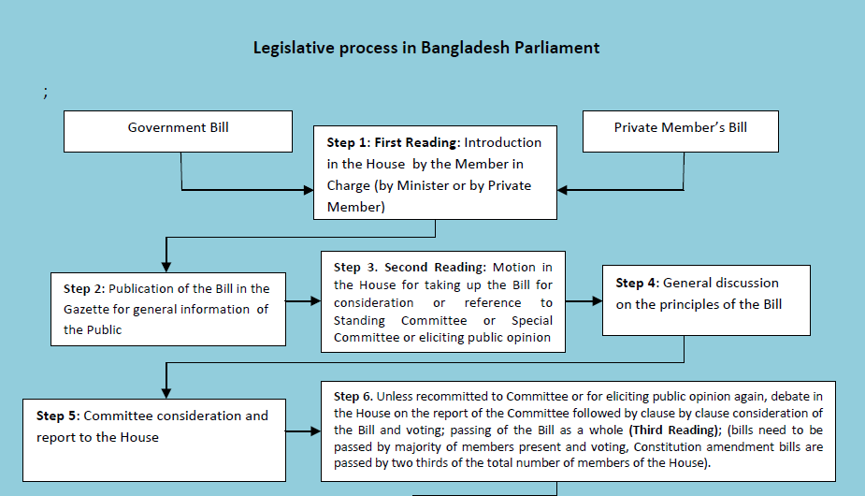

Slide 25
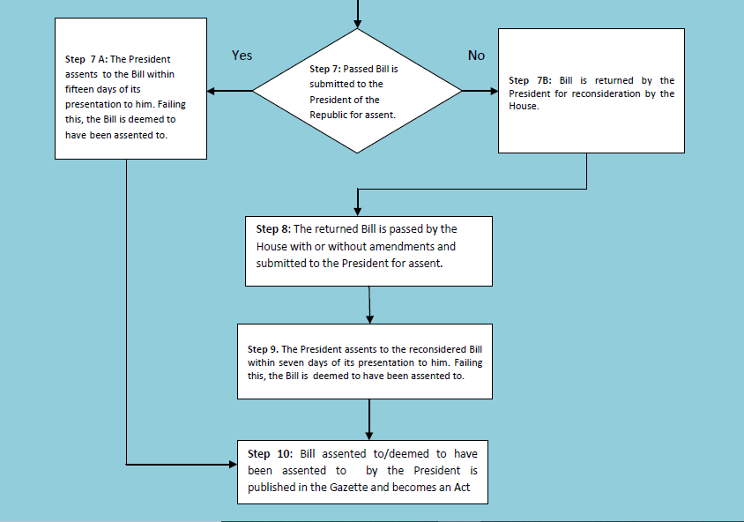

Slide 26
Roles and Functions of Parliament
Law Making
Control Over Budget
Control Over Executive
Ensuring accountability of the Government

